Slide 1
Evaluating Classifier Performance using PySpark for CardioVascular Disease Prediction

Slide 2
Group-8 Team
Under the Guidance of
Professor Dr. Nabajyoti Mazumdar
Mentors
Mohammad Shahnawaz
Om Prakash Kushwaha
Priyamvada Priyadarshani (IIB2020037)
Kavita Dharamshaktu (IIT2020002)
Prachi Gupta (IEC2020040)
Sanskruti Mane (IIB2020020)
Members

Slide 3
INTRODUCTION
Cardiovascular disease (CVD) remains a global health challenge, causing millions of fatalities annually. This multifaceted condition includes disorders like coronary artery disease, heart failure, and stroke. Recognizing modifiable risk factors, such as hypertension, diabetes, obesity, and lack of exercise, is crucial for prevention.

Slide 4
Literature Review

Slide 5
Paper | Author | Title of the paper | Year | Methodology | Limitations
[1] | Ashutosh Shankhdhar | Visualization and Prediction of Heart Disease using Big Data Analytics | 2022 | Proposes a machine learning approach for real-time heart disease detection, with a stacked model outperforming others. | Not real time analysis and no BDA tools used so in future we can explore real time analysis and utilize BDA framework to enhance system efficiency in terms of speed and accuracy and can analyse different ML algo further.
[2] | Sara Ashraf, Yasmine M. Afify, Rasha Ismail | Big Data for Real-Time Processing on Streaming Data: State-of-the-art and Future Challenges | 2022 | Data ingestion with Twitter Streaming API and Apache Flume has been done. Apache Kafka, is employed to transport data efficiently. Data preprocessing entails activities such as filtering out incorrect meanings, removing URL links, and handling user mentions and emoticons in tweet content. | The use of Apache Kafka, while effective for high-velocity data streams, can result in increased storage costs due to the maintenance of duplicate copies of data. While Apache Spark excels in iterative analysis, it is not suited where data must be processed only once before being written to disk.

Slide 6
Paper | Author | Title of the paper | Year | Methodology | Limitation
[3] | Abderrahmane Ed-Daoudy, Khalil Maalmi & Aziza El Ouaazizi | A scalable and real-time system for disease prediction using big data processing | 2020 | The system's architecture involves users tweeting health-related attributes, processed in real-time via Spark streaming and Kafka. Machine learning predicts health status from the data, returning relevant messages to users via Twitter. | They did not consider the case if IOT device data to be used as input especially when IOT devices provide the opportunity of 24 hour surveillance.
[4] | Fawzya Hassan, Masoud E. Shaheen & Radhya Sahal | Real-Time Healthcare Monitoring System using Online Machine Learning and Spark Streaming | 2020 | Implemented on Apache Spark using Scala, the system utilizes Spark Streaming and Kafka for data processing and input. The Streaming Linear Regression With SGD algorithm predicts patient status from streaming data. | Data Quality, Privacy Concerns, Model Training, Generalization

Slide 7
Paper | Author | Title of the paper | Year | Methodology | Limitation
[5] | Kwok Tai Chui, Ryan Wen Liu, Miltiadis D. Lytras & Mingbo Zhao | Big data and IoT solution for patient behaviour monitoring | 2019 | Develop and test a system for handling large-scale, high-velocity data from diverse IoT sensors. Including those for blood pressure, body temperature, electrocardiogram, and other biometric measurements. | The paper lacks real-world case studies and comprehensive analysis, focusing on just two patient monitoring applications

Slide 8
Problem Statement
Current management approaches are primarily reactive, identifying CVD after noticeable symptoms appear, missing early intervention opportunities.
Management of vast volumes of sensitive patient data.
Integration of IoT devices with analytical tools like PySpark poses technical challenges that require careful configuration and robust data processing mechanisms.

Slide 9
Original Dataset - Cardio.csv
unique identifier for each individual
Age
gender: ’1’ for males and ’2’ for females.
Height
weight
ap-hi: systolic blood pressure.
ap-lo: diastolic blood pressure.
cholesterol: classified cholesterol levels into categories ’1’, ’2’, or ’3’.
gluc: classified glucose levels as ’1’, ’2’, or ’3’.
smoke: ’0’ represents non-smokers and ’1’ represents smokers.
alco: ’0’ indicating non-drinkers and ’1’ for individuals who consume alcohol.
active: ’0’ indicating inactive and ’1’ representing active individuals.
cardio

Slide 10
Data Preprocessing | Feature Significance Testing | Dataset Splitting for Machine Learning
No missing values present. | Investigated significance of the new BMI feature in the dataset. | Split the dataset into two subsets: training and testing.
Converted Age in years. |  | Essential for evaluating model generalization and performance on unseen data.
Created a new feature: BMI using weight and height

Slide 11
Correlation Analysis

Slide 12
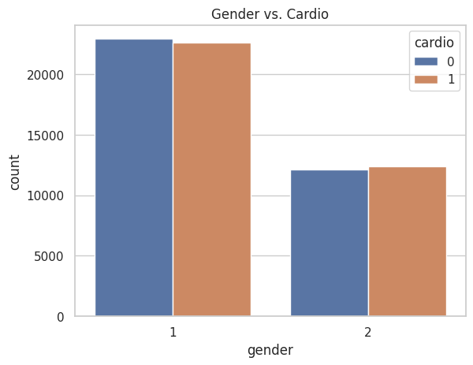
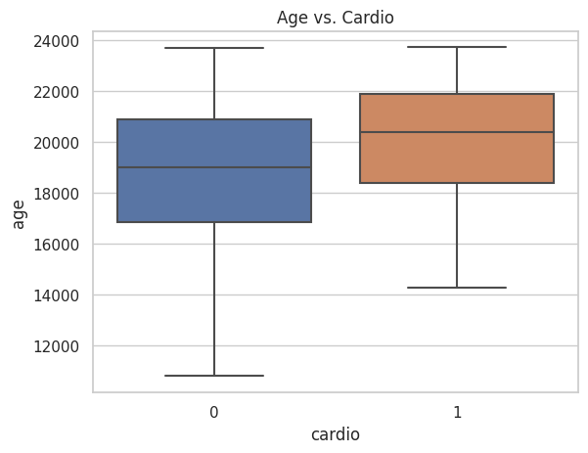
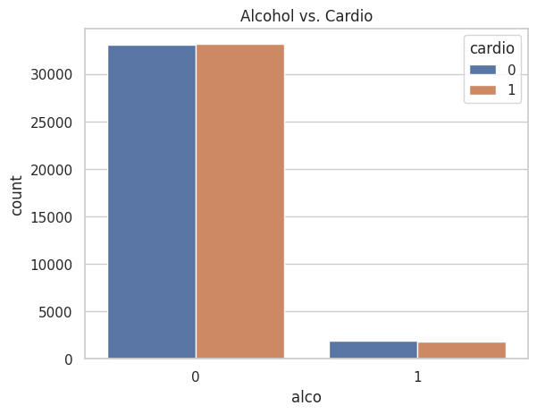
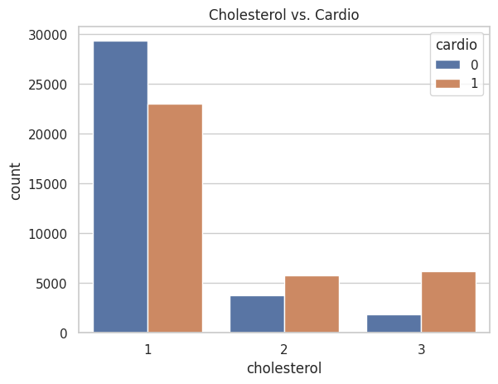
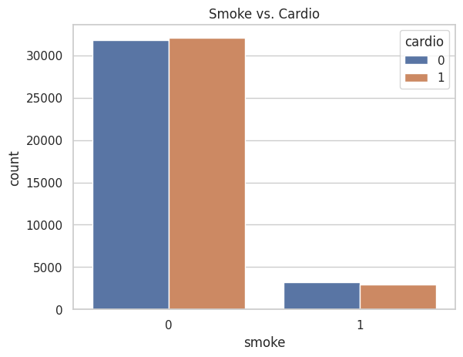
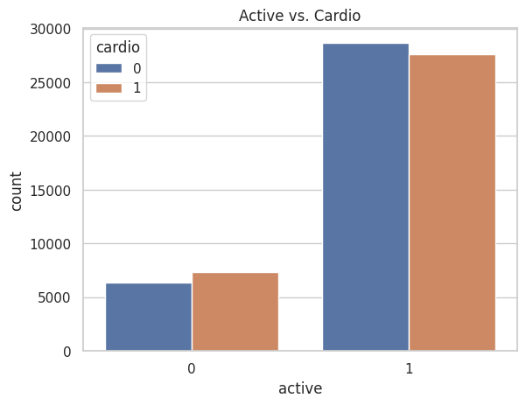

Slide 13
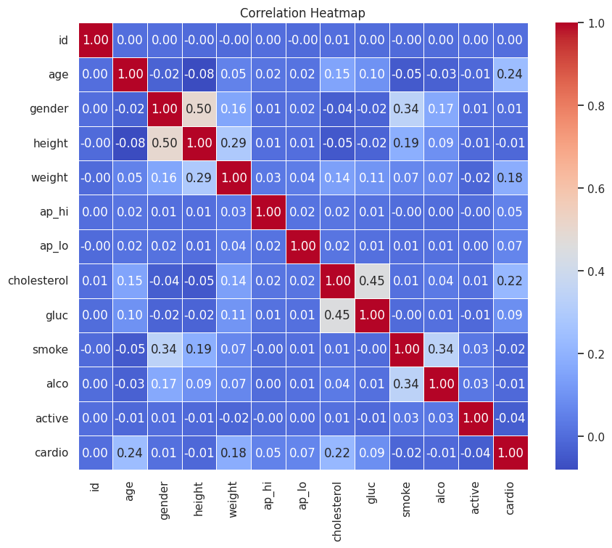

Slide 14
Proposed Methodology

Slide 15
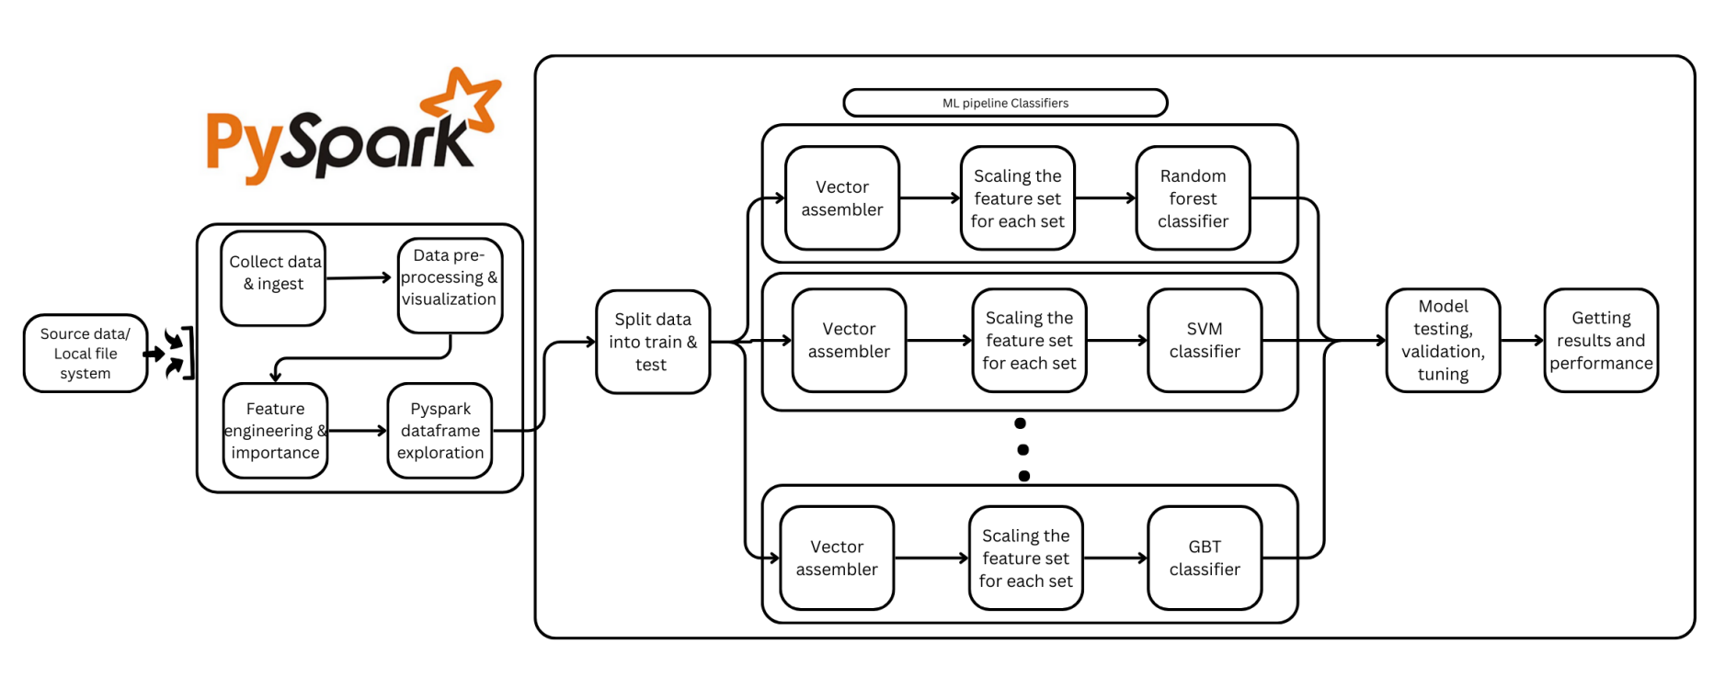
Architecture

Slide 16
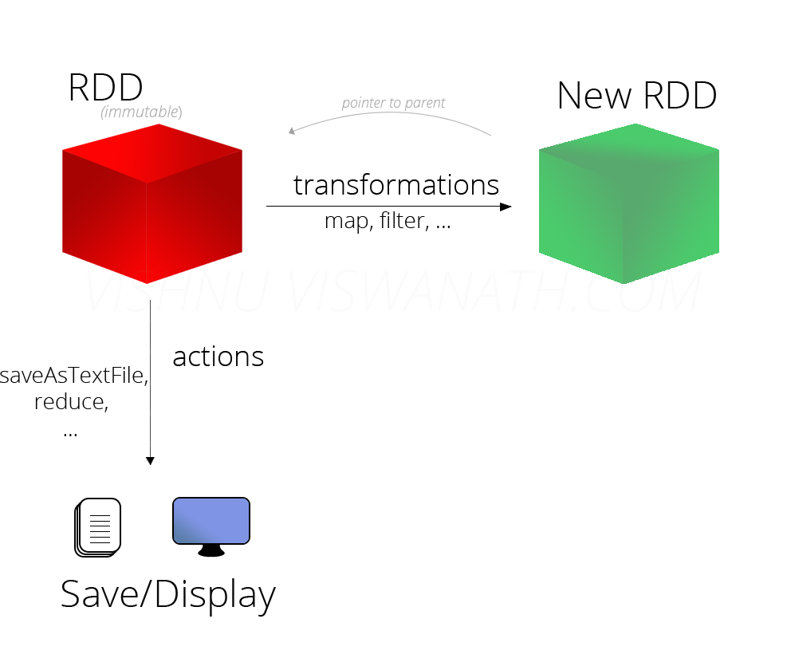

3.0.0
In-memory processing
For transformations, Spark adds them to a DAG of computation and only when driver requests some data, does this DAG actually gets executed. Spark is lazy.
RDD & lineage creation, checkpointing for fault tolerance
Columnar storage format, Ideal for analytical queries, providing better compression and quicker access.
Optimized execution plans for DataFrame transformations, logical and physical optimizations to lower computational costs.

Slide 17
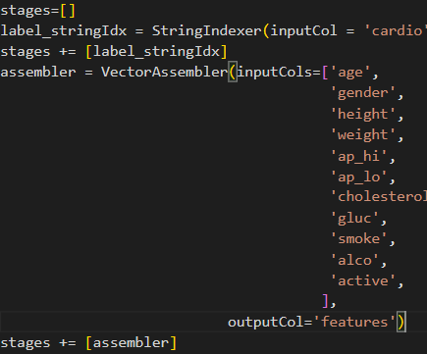
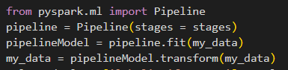
Data preparation & Pipeline
Original: 70000 rows and 13 columns(12 features and 1 Prediction)
Filtering out the absurd diastolic and systolic blood pressure values: 68781 rows/instances.
StringIndexer, VectorAssembler, StandardScaler

Slide 18
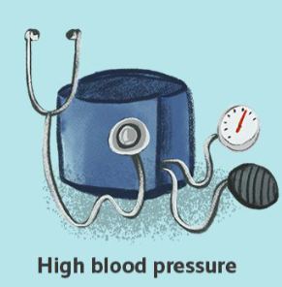
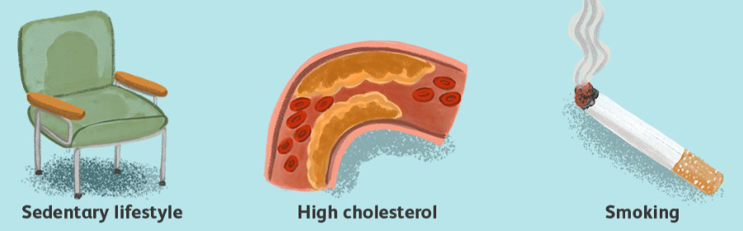

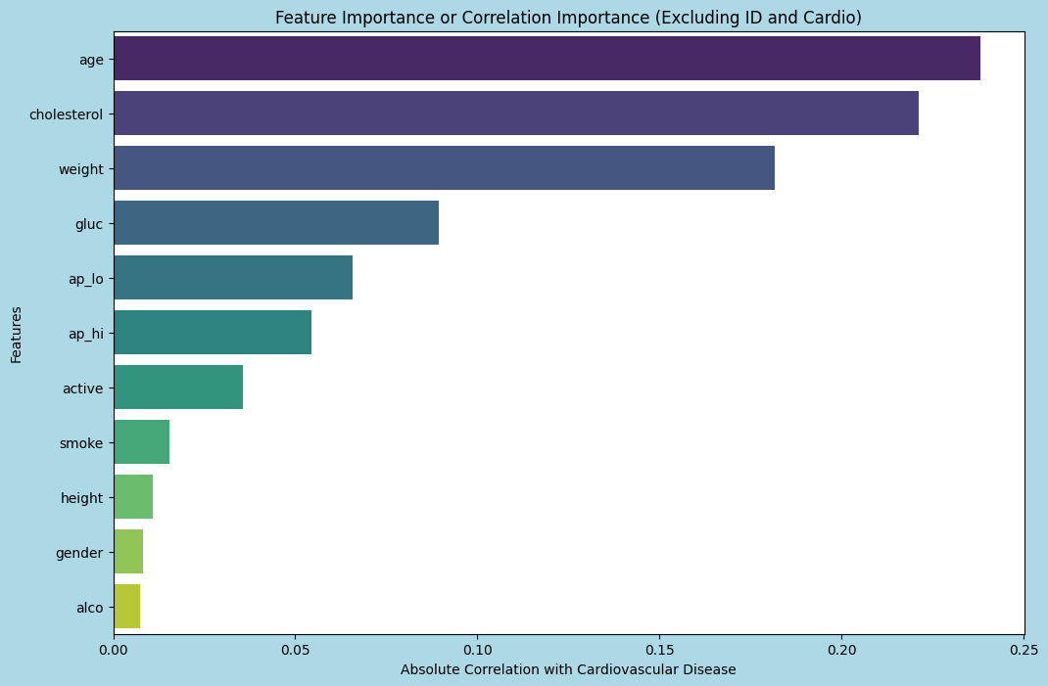

Feature Selection
All Original features
Correlation-based features
Custom-Engineered Features: the 'age-in-years' feature & bmi ;
Feature Importance-Based Features: Applied Random forest and Top 5 Feature came out to be [ap-hi: 0.5448; ap-lo: 0.2651; age: 0.0817; cholesterol: 0.0849; weight: 0.0157;(bmi: 0.0148)]
Training Dataset Count: 48144; Test Dataset Count: 20637

Slide 19

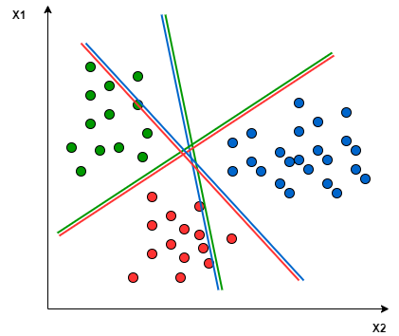
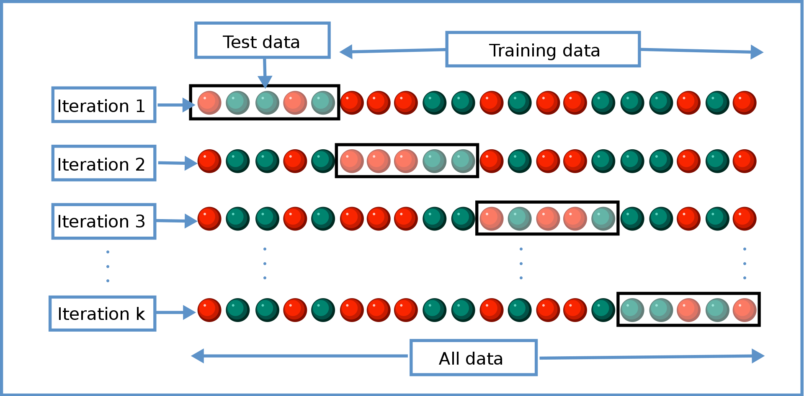
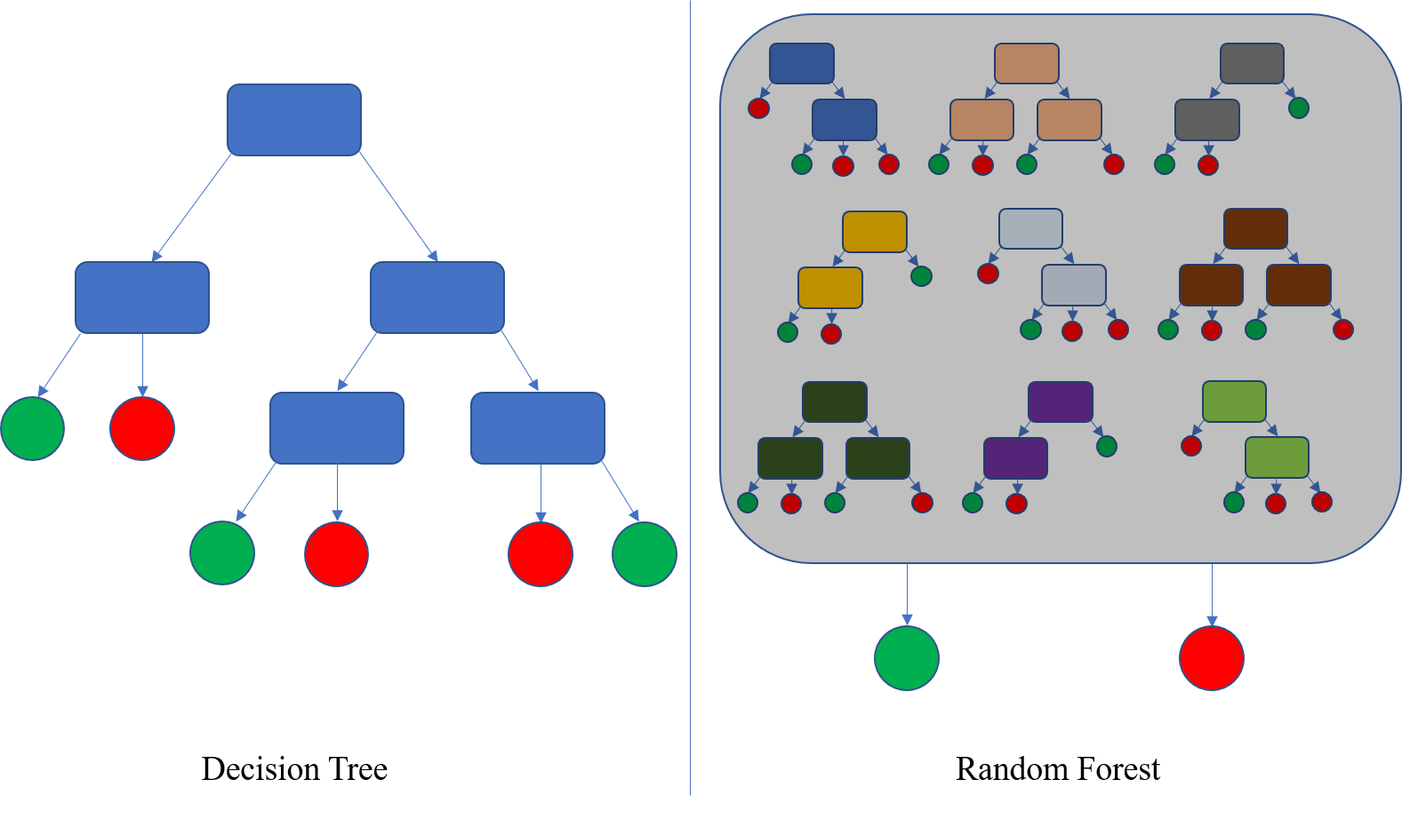
HEART DISEASE DIAGNOSIS
Applied SVM & Multilayer Perceptron(ReLU by default)
Applying Logistic Regression, Decision tree Regressor, Random Forest Regressor, GBT with 5-fold cross-validation (Details in the code); hyperparameter grid search as per inputs maxIter, numTree, maxDepth, regParam, ElasticNetParams etc
For DT, RF, GBT, tree rules were generated ,

Slide 20
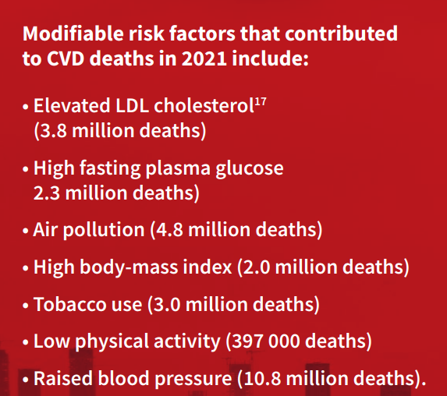
Code Links
CONFRONTING THE
WORLD’S NUMBER
ONE KILLER
DMMSN_CARDIO.ipynb - Colaboratory (google.com)
DMMSN_C2_PIPELINE.ipynb - Colaboratory (google.com)
Result comparison.ipynb - Colaboratory (google.com)
SVM/MLP & feature engineering.ipynb - Colaboratory (google.com)
different data DMMSN_C2_PIPELINE.ipynb - Colaboratory (google.com)
Forest data.ipynb - Colaboratory (google.com)

Slide 21
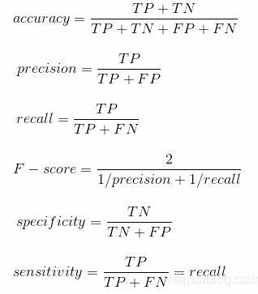
Performance Metrics
Accuracy, Precision, Recall, F-score, Area under ROC curve calculated, sensitivity, specificity, compared and plotted using BinaryClassificationEvaluator().
Confusion matrix were drawn as well.

Slide 22
Analysis & Results - Cardio dataset
 | Random Forest | Decision Tree | Logistic Regression | Multilayer Perceptron | SVM (LinearSVC) | GBT Classifier
Accuracy | 69.14% | 72.27% | 71.41% | 71.43% | 71.18% | 73.05%
F1-score | 0.68 | 0.72 | 0.71 | 0.71 | 0.71 | 0.73
Precision | 0.69 | 0.72 | 0.71 | 0.71 | 0.71 | 0.73
Recall | 0.69 | 0.72 | 0.70 | 0.71 | 0.71 | 0.73

Slide 23
Testing the model with Imbalanced Dataset
 | Random Forest | Decision Tree | Logistic Regression | Multilayer Perceptron | SVM (LinearSVC) | GBT Classifier
Accuracy | 80.68% | 82% | 77% | 78% | 85% | 83%
F1-score | 0.81 | 0.82 | 0.77 | 0.78 | 0.85 | 0.83
Precision | 0.80 | 0.81 | 0.77 | 0.78 | 0.85 | 0.83
Recall | 0.77 | 0.80 | 0.76 | 0.78 | 0.84 | 0.82

Slide 24
CONCLUSIONS
Through a variety of machine learning models, including Logistic Regression, Decision Tree Classifier, Gradient Boosted Tree (GBT) Classifier, SVM, Multilayer Perceptron, and Random Forest Classifier, we have tried to predict the cardiovascular disease.
In summary, a multifaceted approach, combining IoT devices, big data analytics, and advanced data processing platforms, offers the potential for early detection and effective management of CVD, enabling timely interventions and cost reductions, ultimately preserving lives.

Slide 25
REFERENCES
World Heart Federation. "World Heart Report 2023: Confronting the World’s Number One Killer." Geneva, Switzerland. 2023.
Chui, K. T., Liu, R. W., Lytras, M. D., & Zhao, M. "Big Data and IoT Solution for Patient Behavior Monitoring." Published online: 27 Feb 2019.
Shankhdhar, A. "Visualization and Prediction of Heart Disease using Big Data Analytics." In: 11th International Conference on System Modeling & Advancement in Research Trends (SMART), 2022.
Ed-Daoudy, A., Maalmi, K., El ouaazizi, A., et al. "A Scalable and Real-time System for Disease Prediction Using Big Data Processing." Preprint available at Research Square, 09 March 2023.
Sun, J., & Reddy, C. K. "Big Data Analytics for Healthcare." In: Proceedings of the 19th ACM SIGKDD International Conference on Knowledge Discovery and Data Mining, 2013.
Archenaa, J., & Anita, E. M. "Interactive Big Data Management in Healthcare using Spark." In: Proceedings of the 3rd International Symposium on Big Data and Cloud Computing Challenges (ISBCC–16’), 2016.
Nair, L. R., Shetty, S. D., & Shetty, S. D. "Applying Spark-based Machine Learning Model on Streaming Big Data for Health Status Prediction." Computers, Electrical Engineering, 2018.
Alotaibi, S., Mehmood, R., Katib, I., Rana, O., & Albeshri, A. "Sehaa: A Big Data Analytics Tool for Healthcare Symptoms and Diseases Detection using Twitter, Apache Spark, and Machine Learning." Applied Sciences, 2020.
Ed-Daoudy, A., & Maalmi, K. "Real-time Machine Learning for Early Detection of Heart Disease Using Big Data Approach." In: 2019 International Conference on Wireless Technologies, Embedded and Intelligent Systems (WITS).
Ashraf, S., Afify, Y. M., & Ismail, R. "Big Data for Real-Time Processing on Streaming Data: State-of-the-Art and Future Challenges." In: 2022 International Conference on Electrical, Computer, Communications and Mechatronics Engineering (ICECCME), 2022.

Slide 26
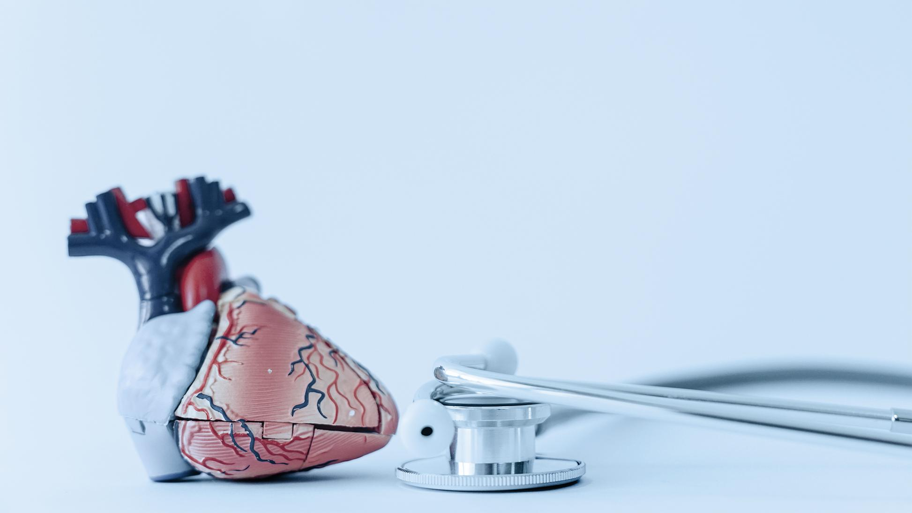

Slide 27
THANK YOU!

